Slide 1
Age Structured Production Models using Integrated Analysis
Richard D. Methot Jr.
NOAA Fisheries
Seattle, WA USA

Slide 2
Outline
Goal: create age-structured, integrated models for data-poor problems for which biomass dynamic models are typically applied
Example 1: Schaefer model
Example 2: Depletion corrected average catch
Conclusions

Slide 3
Example 1: Schaefer model
Data are 30 years of catch and CPUE (1961-1990)
Example swordfish-like dataset from ASPIC (A Stock-Production Model Incorporating Covariates)
ASPIC available from NOAA Fisheries Toolbox http://nft.nefsc.noaa.gov/

Slide 4
Schaefer model
Schaefer model implemented in ASPIC
B_{y+1} = B_{y} + r B_{y} (1 - B_{y} /K ) - C_{y}
Estimated parameters are
MSY (maximum population growth rate)
K (equilibrium biomass)
Q (catchability)

Slide 5
Stock Synthesis Model
Fully age structured (plus group = age 10, with arbitrary inputs for growth, maturity, and fecundity)
All ages fully selected
All ages mature
Estimated parameters are
R₀ (equilibrium recruitment)
either M (natural mortality) or h (steepness)
catchability as derived quantity

Slide 6
Comparing model results

Slide 7
Comparing model results
 | B₁₉₉₀ / B₀ | MSY | B₀ | M | h | r
Schaefer | 0.241 | 1.15E+07 | 1.17E+08 |  |  | 0.394
SS_est_h | 0.255 | 1.12E+07 | 1.86E+08 | 0.200 | 0.867
SS_est_M | 0.261 | 1.27E+07 | 1.35E+08 | 0.302 | 0.999
Fixed inputs in bold

Slide 8
Conclusions from Schaefer example
Age structured production model requires no more estimated parameters than Schaefer model
Fit to CPUE data is similar
Model output is similar
ASPIC allows additional flexibility with estimating initial depletion and ratio of B_{MSY}/K
SS allows additional flexibility in many many directions

Slide 9
Example 2: Depletion Corrected Average Catch

Slide 10
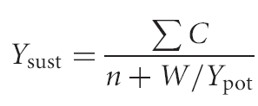

Example 2: Depletion Corrected Average Catch
Simple calculation for data-poor fishery
Estimates a yield that is likely to be sustainable
Based on few inputs: M, average catch, depletion estimate
Boils down to: where, , C is catch, Δ is relative decrease in abundance over n years, c = F_{MSY}/M
Reference: MacCall, A.D. 2009. Depletion-corrected average catch: a simple formula for estimating sustainable yields in data-poor situations. ICES J. Mar. Sci. 66: 2267–2271.

Slide 11
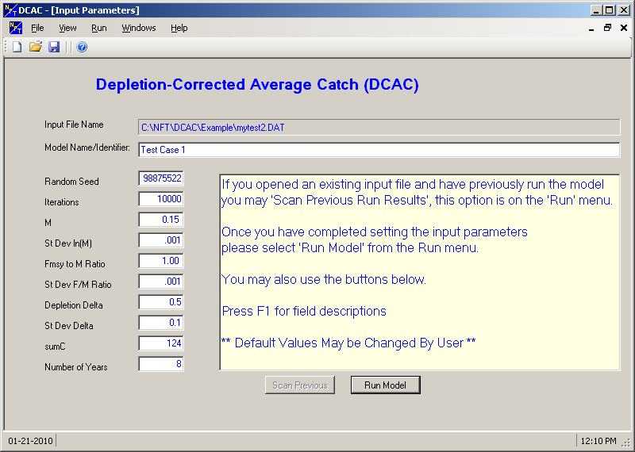
Depletion Corrected Average Catch
NOAA Fisheries Toolbox software
estimates uncertainty using Monte-Carlo sampling for M, F_{MSY}, and Δ
SS comparison considering only uncertainty in Δ (CV = 0.1)

Slide 12
Depletion Corrected Average Catch
Example corresponding to example DCAC download from NOAA fisheries toolbox (NFT): ΣC = 124, n = 8, M = 0.15, c = 1
Δ = relative decline in abundance: input values ranging from 0 (no decline) to 0.7
Uncertainty estimated as implemented in NFT model, but with CV of 0.1 applied to 1 – Δ.
Compare to integrated analysis model from SS

Slide 13
Stock Synthesis Model
Fully age structured (with specified inputs for growth, maturity, and fecundity)
All ages fully selected
Steepness fixed at 1.0
Starting at equilibrium
One 2 data points: Δ as index of abundance
value of 1.0 with no error in first year
value of 1.0 – Δ with CV = 0.1 in last year
Single estimated parameter:
R₀ (equilibrium recruitment)

Slide 14
Comparing DCAC to SS
Similar results when change in abundance is high
SS estimates are higher and more uncertain with less informative data

Slide 15
Conclusions from DCAC example
If no depletion has occurred, then data provided to SS have zero information about MSY
DCAC method doesn’t seek MSY, but simply a sustainable yield
For cases with greater depletion, results are very similar

Slide 16
Potential extensions of DCAC-like integrated analysis model
Provide a time series of abundance rather than simply Δ = change in relative abundance
Input or estimate an initial equilibrium catch or fishing mortality
Incorporate any other data available now or in the future

Slide 17
General conclusions on age structured production models
More options than simpler biomass dynamic models
provides greater ability to explore alternative scenarios and uncertainty
but requires more thinking about choices made
Parameters have more direct biological interpretations
Allows increase in complexity (and realism) through incorporation of additional data types
data on growth and maturity (or external estimates)
a single length or age composition would allow estimation of selectivity
priors based on biological parameters from similar species

